Slide 1
COUNCIL OF THE DISTRICT OF COLUMBIA PERFORMANCE OVERSIGHT HEARING FY2016-17 John A. Wilson Building Wednesday, March 8, 2017 DC Health Benefit Exchange Authority Mila Kofman, JD Executive Director

Slide 2
DC Health Link is the on-line health insurance marketplace for residents and small businesses in the District of Columbia. Established to get people covered and provide transparency, encourage market competition, and simplify the purchase of insurance, providing residents and small businesses the type of market power only large employers had in the past.

Slide 3
DC HEALTH LINK
HBX is a private-public partnership
Although last state to start building IT, was 1 of 4 states that opened on time and stayed open (Bloomberg News)
Congress and President Obama enrolled
HBX fights for all our customers to ensure broad product choices and best possible premiums (created new market for individual dental coverage and vision)

Slide 4
RECOGNITION
Out2Enroll’s: “Key Lessons for LGBT Outreach and Enrollment Under the Affordable Care Act”
Kaiser Family Foundation: “Taking Stock and Taking Steps: A Report from the Field After the First Year of Marketplace Consumer Assistance Under the ACA”
PR Week: DC Health Link -- 2015 Finalist for the Community Relations Campaign of the Year
KFF: ranked 1 for sign-ups of eligible enrollees (2016)

Slide 5
RECOGNITION
AWS “Best Practices in Innovation 2016 Winner” (open source code, agile development, in the cloud) (June 2016)
Ranked #1 (SBMs and FFM) for consumer shopping tools by Clear Choices (January 2017)
First in the nation state-based marketplace partnership. Selected by the Massachusetts Health Connector to provide IT SHOP solution and on-going operations for the MA SHOP. (Feb 2017)

Slide 6
ACA is working in DC
96+% of District residents now have health coverage
Have lowest uninsured rate ever
Uninsured rate cut in half
Rank 1, 2, or 3 (depending on survey) for lowest uninsured nationally (3.7%-4% uninsured)

Slide 7
ACA coverage expansion in DC
2016 Survey conducted by Center for the Study of Services for HBX found:
1 in 4 people with individual private health insurance were uninsured prior to enrolling through DC Health Link.
1 in 2 people determined eligible for Medicaid were uninsured before applying.
4 in 6 small businesses did not offer health insurance to their employees prior to enrollment through DC Health Link.

Slide 8
2017 HEALTH INSURANCE OPTIONS THROUGH DC HEALTH LINK
Plans: 151 Small Group Plans and 20 Individual (includes 2 catastrophic)
SHOP prices competitive: one product had a 19% premium decrease
136 SHOP and 26 Individual in 2016
Insurers: 2 Aetna Companies (group only); CareFirst BlueCross BlueShield; Kaiser Permanente; 3 United HealthCare Companies (group only)
Also offer Dental Coverage (SHOP and Individual) and Vision (Individual)

Slide 9
Historical and current
Since October 1, 2013 to present DC Health Link has served more than 300,000 people: 40,736 people have enrolled in a private individual health insurance, 186,605 people have been determined eligible for Medicaid, and 80,137 people have enrolled through the DC Health Link small business marketplace (includes Congressional enrollment).
Current enrollment: 66,222 covered lives in SHOP (paid); 19,422 (paid)

Slide 10
TYPE | Plan Year 2017 | Plan Year 2017 % | Plan Year 2016 | Plan Year 2016%
Auto Renewals | 14,081 | 58% | 13,815 | 59%
Active Renewals | 2,231 | 9% | 3,085 | 13%
New Customers | 7,245 | 30% | 6,012 | 25%
Special Enrollment | 673 | 3% | 605 | 3%
TOTAL (plan selection) | 24,230 | 100% | 23,517 | 100%

Slide 11
2017 (Paid) Enrollment by Age - Individual

Slide 12
2017 (Paid) Level of Coverage - Individual

Slide 13
IT TAKES A VILLAGE
DC Health Link Business Partners
DC Health Link Assisters
DC Health Link Navigators & Certified Application Counselors
DC Health Link Certified Brokers
DC Government Agencies
Faith-based Community
Community Organizations
Local Businesses

Slide 14
OUTREACH AND ENROLLMENT EVENTS
“Brunch Bounce” popular with young adults
“The College Football Championship Night” at Red Rocks Bar and Grill
Fact Mobs
Movie Nights Out (“Star Wars”)
Beauty and Barber Day
Door-to-Door Canvassing
9 enrollment sites; one touch events

Slide 15
OUTREACH TO TARGETED COMMUNITIES
LGBT Community - Enrollment Night, Twitter chats with partners Out2Enroll, HHS and Young Invincibles
Latino Week of Action - Leadership Health Symposium; Enrollment Days at Embassies
Asian American - Pacific Islander Week of Action - Mobile van in Chinatown
African American Week of Action - MLK Day Parade, Beauty and Barber Days with “Boyz 2 Men” and “Girls 2 Curls”
National Youth Enrollment Week - Café Crawl, Social Night at Bars, Wizard’s Game
Culturally Diverse Outreach Materials and Ads

Slide 16
SHOP Employers
Level of Coverage: more than half in platinum, 29% gold; 19% silver; 2% bronze
Employer Contribution: Nearly half (48%) of employers pay 100% of the premium for their employees; 27% of employers pay between 51% and 99% of premium; 25% of employers pay 50% of premium

Slide 17
EMPLOYER SIZE | ONE PLAN | ALL PLANS FROM CARRIER (ALL METAL LEVELS) | ALL CARRIERS AND PLANS IN ONE METAL | TOTAL
1<9 | 1,335 | 1,227 | 207 | 2,769
10<24 | 327 | 469 | 60 | 856
25<50 | 104 | 181 | 9 | 294
51<100 | 1 | 2 |  | 3
101< |  |  | 3 | 3
TOTAL | 1,767 | 1,879 | 279 | 3,925

Slide 18
SHOP: AGE | PERCENT
< 18 | 19%
18 - 25 | 10%
26 - 34 | 24%
35 - 44 | 18%
45 - 54 | 15%
55 - 64 | 11%
65+ | 3%
TOTAL | 100%

Slide 19
2016 – What’s New?
Enhancements to Plan Match/anonymous shopping:
pharmacy look-up tool
Spanish language version of Plan Match
Plan Shopping Improvements:
customers eligible for CSR see silver level plans (required to receive the reductions) at the top of search list
reordered metal levels: catastrophic, bronze, silver, gold, platinum
icon for standard plans to make it easier for customers to identify
new filters to enable customers to search for HSA-compatible plans
Password Reset and Setup:
option for an emailed secure link to click to reset password
creation of password with prompts (elements required to meet security protocol and checkmark when each requirement met)

Slide 20
What’s New for Small Businesses and Brokers
New account features:
all invoices (current and past) in account
reports with current, historical, & upcoming plan year enrollments
streamlined employees’ information
flash notices from employers to employees on their computer screen when logged onto their DC Health Link account
General Agency Portal for Brokers
Improved Employer Reporting for Brokers:
key information on each group (renewal date, status of enrollments during open enrollment, & changes during the plan year)
all reports downloadable into an Excel spreadsheet
Dental Coverage for SHOP (added spring 2016)

Slide 21
IT 2017 Planned
Plan Match for SHOP (spring 2017)
MOBILE App for Brokers and employers (spring 2017) and for individuals and families (fall 2017)
Broker Quoting Tool (spring 2017)
COBRA/Continuation Coverage Functionality for Small Business Customers (spring 2017)
Improved Plan Display based on user one on one testing (ongoing)
Nationwide Doctor Directory (fall 2017)
Self-Service Billing Inquiries and Payment (fall 2017/winter 2018)
Plan Quality Ratings (fall 2017)

Slide 22
Pre-ACA
45,000 people died annually because they did not have health coverage (Harvard 2009)
Medical expenses were the leading cause of personal bankruptcy. Most people had health insurance but it did not work when they became sick (Warren et al).
People were locked into jobs because they needed good health coverage.

Slide 23
Pre-ACA
No guaranteed issue: people denied health insurance because of past or present medical needs
Rates higher for: health and claims experience, gender, age (no restrictions), industry/occupation, duration of coverage, tobacco and for small businesses these and group size
Preexisting conditions not covered
Annual and lifetime limits allowed
No maternity coverage in individual health insurance

Slide 24
ACA: consumer protections mean that no resident is denied coverage and health insurance now works not just when you are healthy but also when you are sick.
All health insurance sold to individuals, families, and small businesses must cover essential health benefits: primary and specialty care, hospital stays, lab work, preventive care (with no cost sharing), maternity care, mental health and substance abuse treatment.
People cannot be denied coverage or charged more because they had a medical condition in the past or currently.
Pre-existing medical conditions cannot be excluded from coverage.
No rate ups allowed except for age (1:3 limits). Women are no longer charged higher rates than men. No tobacco rating in DC.
Annual and lifetime limits on coverage are prohibited.

Slide 25
ACA: premiums more affordable
Advanced Premium Tax Credits (APTC): if your income is below 400% of federal poverty level (e.g. income under $47,520 for single adult), pay a reduced monthly premium and the IRS pays the rest directly to the insurance company of your choice. People with up to 250% FPL qualify for cost sharing reductions to help pay for coinsurance and other out of pocket expenses.
Federal lawmakers should be looking at providing higher APTC and should expand it to cover more people.

Slide 26
Protect people’s health care
Diverse group: patient and consumer advocates, physicians, hospitals, small business associations, community health centers, brokers, a health plan
Develop options for local policy interventions when there is a bill
Technical changes/clean-up as necessary

Slide 27
DC Health Link Outreach Video
https://youtu.be/deHa6gC058I

Slide 29
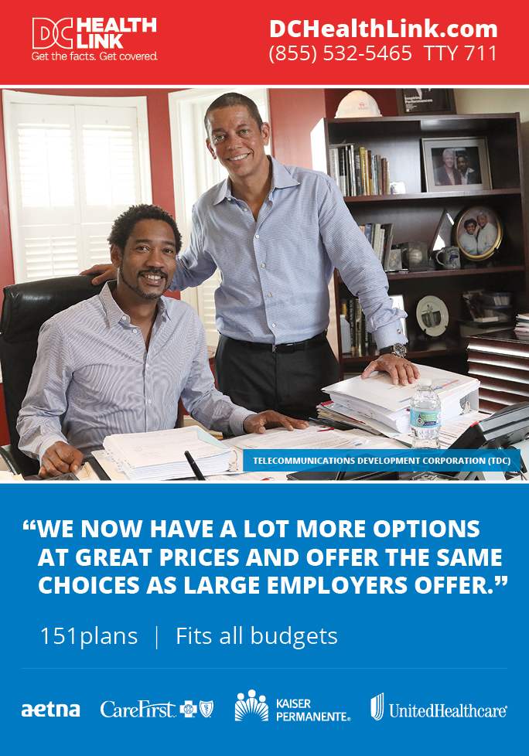

Slide 32
BUSINESS PARTNERS

Slide 33
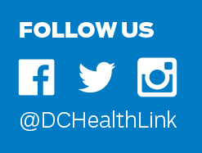
TO LEARN MORE:
Visit us at www.DCHealthLink.com

