Slide 1
COUNCIL OF THE DISTRICT OF COLUMBIA PERFORMANCE OVERSIGHT HEARING FY2014 DC Health Benefit Exchange Authority Wednesday, February 25, 2015 – 11:00 am John A. Wilson Building – Room 120 Mila Kofman, JD Executive Director DC Health Benefit Exchange Authority

Slide 2
BACKGROUND
Pre-HBX: ACA implementation lead by DHCF, DHS, DISB, & DOH
2012: legislation & HBX Executive Board appointed
Jan 2013: city signs IT contract (OCP-DHS)
Jan 2013: HBX first employee hired
FY2013 oversight: Policy issues, IT, and setting up a new private/public partnership

Slide 3
BUILDING DC HEALTH LINK
Built from the ground up - patient & consumer advocates, physicians, other health care providers, brokers, health plans, small businesses
Was the last state to start IT, but opened for business on time 10/1/2013 for individual and small business customers
Was 1 of 4 states that opened on time and stayed open (Bloomberg News)

Slide 4
BUILDING DC HEALTH LINK
October 2013 designated as the source of coverage for Members of Congress and staff.
December 2013 President Obama enrolled in coverage through DC Health Link (and renewed coverage in December 2014).

Slide 5
BUILDING DC HEALTH LINK
Choices: HMO, PPO, POS; HDHP & zero deductible plans
2014: 267 Small Group Plans and 34 Individual (3 catastrophic)
2015: 192 Small Group Plans and 31 Individual (3 catastrophic)
Insurers: Aetna; Carefirst BlueCross BlueShield; Kaiser Permanente; United HealthCare (group only)

Slide 6
Data 2/23/2015
October 1, 2013 to February 23, 2015 (includes open enrollment and SEPs), 84,937 people have come through DC Health Link:
21,595 people enrolled in private health plans through the DC Health Link individual and family marketplace;
47,527 people determined eligible for Medicaid coverage through DC Health Link; and
15,815 people enrolled through the DC Health Link small business marketplace (includes Congressional enrollment)

Slide 7
INDIVIDUAL COVERED LIVES AGE 2/23/15

Slide 8
Individual Covered Lives by Metal Level 2/23/15

Slide 9
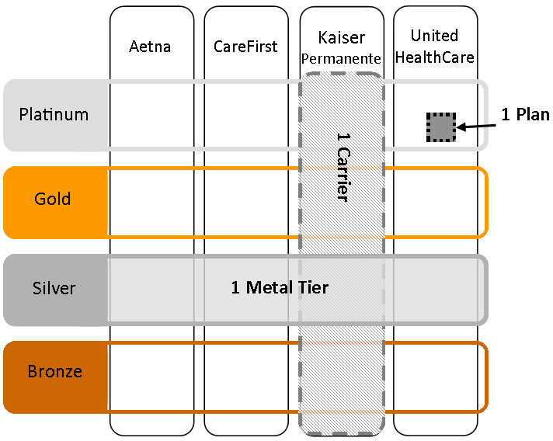
EMPLOYER’S OPTIONS
Employer chooses how many plans to offer to employees:
All Plans - 1 Metal Level
All Plans from 1 Carrier
1 Plan from 1 Carrier

Slide 10
EMPLOYER’S CHOICE (463 EMPLOYERS)
1 Plan 1 Carrier | 154
All Plans 1 Carrier | 207
All Plans (all carriers) 1 Metal Level | 102

Slide 11
SHOP COVERED LIVES - METAL LEVEL (not including Congress) 2/1/2015 data

Slide 12
BUSINESS PARTNERS

Slide 13
UNINSURED RATE CUT BY 43% IN DC
The number of uninsured dropped by as much as 43% during DC Health Link’s first year of operation
18,399 previously uninsured District residents gained coverage through DC Health Link
Approx. 23% of the privately insured enrollees and 55% of the Medicaid eligible people reported being uninsured before applying for coverage through DC Health Link

Slide 14
1ST YEAR: DC HEALTH LINK COVERING UNINSURED BY WARD
WARD | # previously uninsured enrolled in private health insurance | # previously uninsured determined eligible Medicaid | Total # previously uninsured
1 | 467 | 1,411 | 1,878
2 | 346 | 529 | 875
3 | 274 | 543 | 817
4 | 436 | 2,938 | 3,374
5 | 311 | 2,925 | 3,236
6 | 418 | 1,180 | 1,598
7 | 32 | 2,554 | 2,586
8 | 73 | 3,962 | 4,035

Slide 15
IT TAKES A VILLAGE
DC Health Link Business Partners
DC Health Link Assisters
DC Health Link Navigator & Certified Application Counselors
DC Health Link Certified Brokers
DC Government Agencies
Faith-based Community
Community Organizations
Local Businesses

Slide 16
POTUS WITH DC HEALTH LINK ASSISTER

Slide 17
RECOGNITION
Out2Enroll’s: “Key Lessons for LGBT Outreach and Enrollment Under the Affordable Care Act”
Kaiser Family Foundation: “Taking Stock and Taking Steps: A Report from the Field After the First Year of Marketplace Consumer Assistance Under the ACA”
White House Briefing: “The Affordable Care Act and the LGBT Community” (7/24/2014)
White House Summit: “Healthy Young America Conference” (1/15/2015)

Slide 18
FAITH-BASED PARTNERSHIPS
“From the Pulpit to the Pews”: partnered with local churches, mosques, synagogues and other faith entities
Faith In Action Sundays: increased applications and enrollments

Slide 19
SECOND OPEN ENROLLMENT HIGHLIGHTS
Enrollment Storefronts – six locations around the city
One Touch Enrollment Events –
one-stop shopping

Slide 20
SECOND OPEN ENROLLMENT HIGHLIGHTS
Movie Nights at “SELMA”
Boyz 2 Men Barbershop Days
Enroll at the Bowls – College Football Championships
NHL Winter Classic & “Rock the Riverfront” Festival –Teamed with DC Brau
Super Bowl Super Social Sunday & Pizza Delivery

Slide 21
“…. But if you ordered pizza from Pizza 17 in D.C. last night, you probably did hear about health insurance from the District's health exchange. DC Health Link tucked fliers reminding football fans that the Feb. 15 coverage deadline is coming up….” POLITICO PULSE

Slide 22
SECOND OPEN ENROLLMENT HIGHLIGHTS
24 Hour Marathon-Relay
Valentine’s Day Flowers

Slide 23
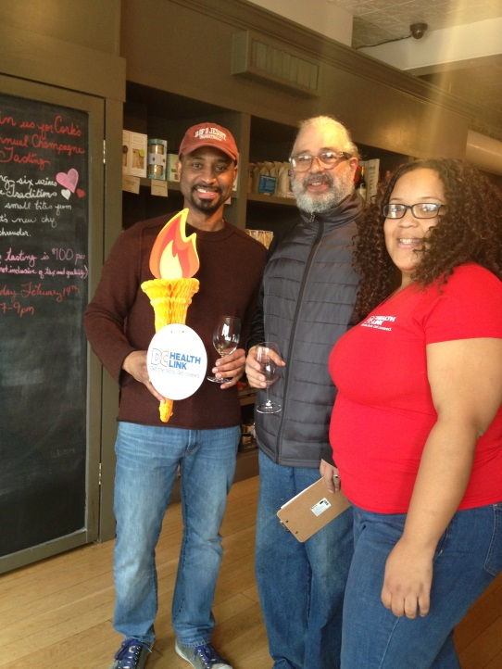
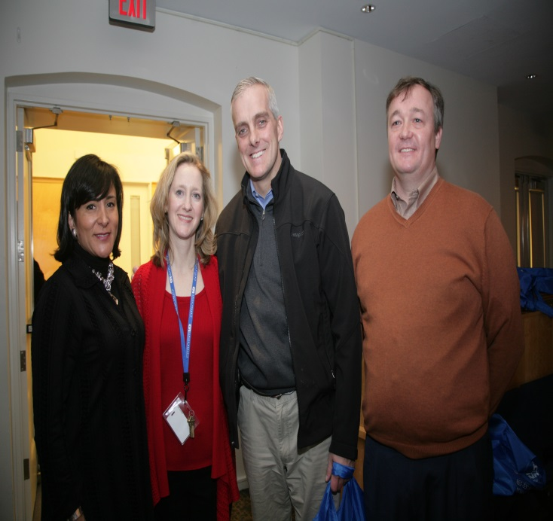
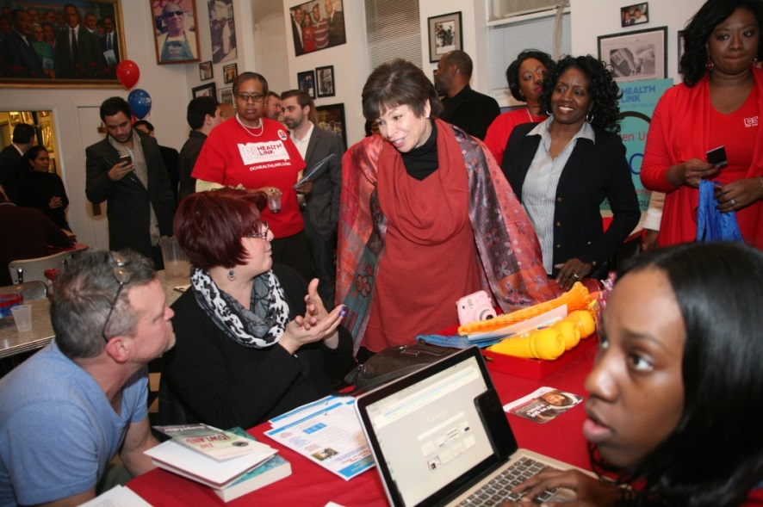
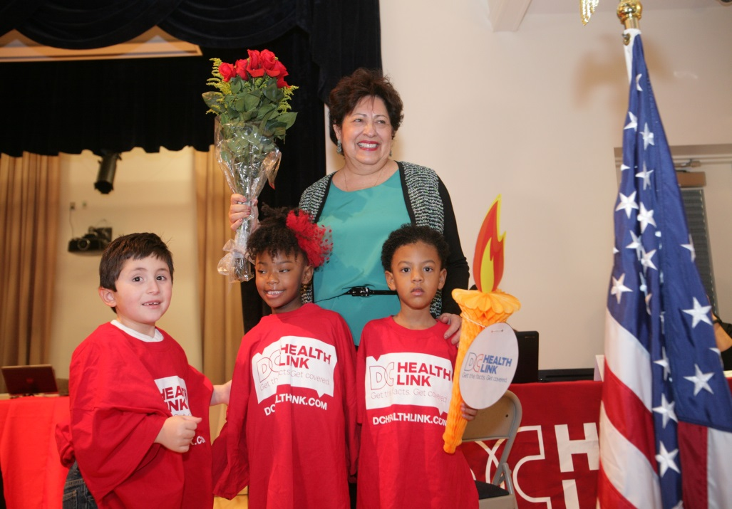
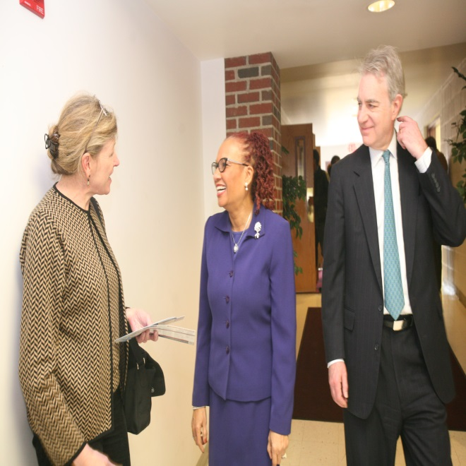

Slide 28
CURRENT PRIORITIES
Process 3/1/2015 enrollments
We find, we fix: IT – add auto functions, improve user experience, continue to find and correct errors/system defects

Slide 29
TO LEARN MORE:
Visit us at www.DCHealthLink.com
Like us on Facebook: DC Health Link
Follow us on twitter @DCHealthLink
Download our Mobile App at iTunes and Google Play

