Slide 1
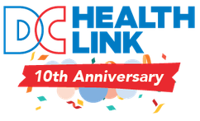
DISB Public Hearing PROPOSED HEALTH INSURANCE RATES FOR 2025 August 20, 2024 Mila Kofman, JD Executive Director DC Health Benefit Exchange Authority

Slide 2
DC Health Link – DC’s Affordable Care Act online health insurance marketplace
Last state to start IT build, 1 of 4 state marketplaces opened for business on time (& stayed open) Oct 1, 2013
Small group & individual market through DC Health Link:
100,000 people
Responsible for over $670 million in annual premiums
Cut uninsured rate in half since DC Health Link opened for business. Near universal coverage with nearly 97% of DC residents covered
DC ranks #2 in U.S. for lowest uninsured

Slide 3
HBX Role in Rate Review
HBX advocates for the lowest possible rates for our small businesses, non-profits, and individual customers.
HBX provides actuarial analysis and policy reasons for the lowest possible rates for DISB’s consideration.
HBX outside actuaries (Oliver Wyman) analyze proposed rate filings:
Identify unsupported assumptions and errors
Work with DISB actuaries

Slide 4
Insurer Proposed Premium Changes 2025 & HBX Recommendations: Individual Marketplace
Insurer | Insurer Proposed Changes (Average) | OW Actuarial Factors Analysis (actuarially justified rate) | HBX Recommendations
CareFirst HMO | 3.60% | 1.45% | Individual market is unaffordable. Do not approve insurers’ proposed rates
CareFirst PPO (GHMSI) | 3.60% | -1.40%
Kaiser Permanente | 9.00% | 8.97%

Slide 5
Small Group Marketplace
Insurer | Insurer Proposed Changes (Average) | OW Actuarial Factors Analysis (actuarially justified rate) | HBX Recommendation
CareFirst HMO | 6.60% | 3.79% | Do not approve insurers’ proposed rates
CareFirst PPO (GHMSI) | 1.70% | -2.85%
Kaiser | 8.00% | 7.97%
United Optimum | 5.08% | 1.70%
United Healthcare Inc. | 5.80% | 2.39%
United Mid-Atlantic HMO | 5.42% | 2.03%

Slide 6
Impact of Premium Increases on HealthCare4ChildCare
HealthCare4ChildCare is a locally funded health coverage program for employees of OSSE-licensed early child development facilities. There is $12 million in local funding allocated to pay for HealthCare4ChildCare health insurance premiums. HBX administers the HC4CC program.
The proposed rate increases have a significant impact on the locally funded HC4CC program.
We estimate the proposed premium increases to cost $1.4 million based on current enrollment. The $1.4 million is more than 10% of the DC FY2025 approved budget for HC4CC.
If proposed rate increases are approved for small group coverage and individual marketplace coverage, this will put financial pressure on the locally funded program.

Slide 7
EXAMPLE: A 29-year old resident purchased the lowest cost bronze plan in 2018 ($6,200 deductible in 2018) and paid $211.11/month. In 2024, that resident pays $391.26/month and has a $6,350 deductible. This is an 85% increase. In the individual marketplace, only 23% of enrollees get lower monthly premium (APTC). This means that 4 of 5 enrollees pay the full premium on a monthly basis.
Individual Market Premium Increases are Unsustainable, Hurt Residents, and Put the District at a Competitive Disadvantage

Slide 8
Premium increases disproportionally impact DC’s Black and Brown residents and families
Median household income in DC by race*:
White households: $159,692
Hispanic/Latino households: $103,762
Black households: $74,714
*Source: https://www.dchealthmatters.org/demographicdata?id=130951&sectionId=936

Slide 9
Individual market premiums in the District are now among the highest in the nation
In 2018, DC had the 4th lowest average premium for Bronze coverage in the nation (tied with NM).* DC had one of the most affordable markets.
In 2024, DC ranks 42nd and is now one of the most unaffordable places for individual health insurance. Our neighbors -- Maryland is #1 and is the most affordable and Virginia is #5 lowest average premium for Bronze.*
*Data Source: https://www.kff.org/health-reform/state-indicator/average-marketplace-premiums-by-metal-tier/

Slide 10
Individual and family health insurance should be affordable for self-employed residents, DC’s entrepreneurs, residents without job-based coverage, and residents losing Medicaid coverage.
Recommendation:
Do not approve carrier requested rate increases for 2025 individual market.

Slide 11
Small businesses and Non-Profits in DC face significant challenges
According to a 2023 report from the DC Policy Center:
The pandemic shifted economic activity away from urban job centers, weakening the District’s economic competitive position.
As people spend less time in the city and more time in the region’s suburbs, D.C. employers operate under a new normal with fewer customers.
Some employers have been able to adapt to these conditions by moving part of their commercial activity online or opening only on nights and weekends, while others have been forced to cut staff, move their location, or close entirely.
Source: DC Policy Center, 2023 State of Business Report: Doing Business Under Fiscal Distress, 2023 State of Business Report: Doing Business Under Fiscal Distress - D.C. Policy Center (dcpolicycenter.org)

Slide 12
Small group premiums are more expensive in DC than in MD and the gap is growing:
In 2016 DC’s premium was 4.6% higher than MD.*
In 2023 DC’s premium was 7% higher than MD.*
DC’s small group premium is less affordable than MD’s small group premium, the gap is growing, and is one factor that makes DC less competitive.
*Source: Robert Wood Johnson Foundation, https://hix-compare.org/ Downloaded August 2, 2024.

Slide 13
Small Group Market Proposed Premiums are Unsustainable for Employers and Workers
Annual and cumulative effect of increasing small group market premiums is hurting District small businesses, non-profits, and their employees.

Slide 14
Annual and cumulative effect of increasing small group premiums is hurting District small businesses, non-profits, and their employees
Example: A District employer with 5 employees ages 28, 30, 32, 45, and 62 enrolled in a gold plan had a 61% increase in annual premium from 2018 paying $30,816 and now in 2024 paying $49,575.
Revenue has not increased by 61%.

Slide 15
Risk-Based Capital Ratio (200% requires action)
 | 2023 | 2022 | 2021 | 2020 | 2019 | 2018 | 2017 | 2016
United Healthcare Insurance Co. | 694% | 814% | 666% | 644% | 539% | 536% | 472% | 480%
United Healthcare of the Mid Atlantic | 767% | 957% | 2780% | 685% | 343% | 519% | 372% | 498%
United Optimum Choice Inc. | 1040% | 538% | 554% | 592% | 760% | 925% | 550% | 701%
CareFirst GHMSI | 904% | 891% | 984% | 1194% | 1088% | 923% | 1011% | 851%
CareFirst BlueChoice | 453% | 461% | 483% | 766% | 845% | 635% | 721% | 807%
Kaiser | 446% | 467% | 507% | 434% | 371% | 529% | 231% | 320%

Slide 16
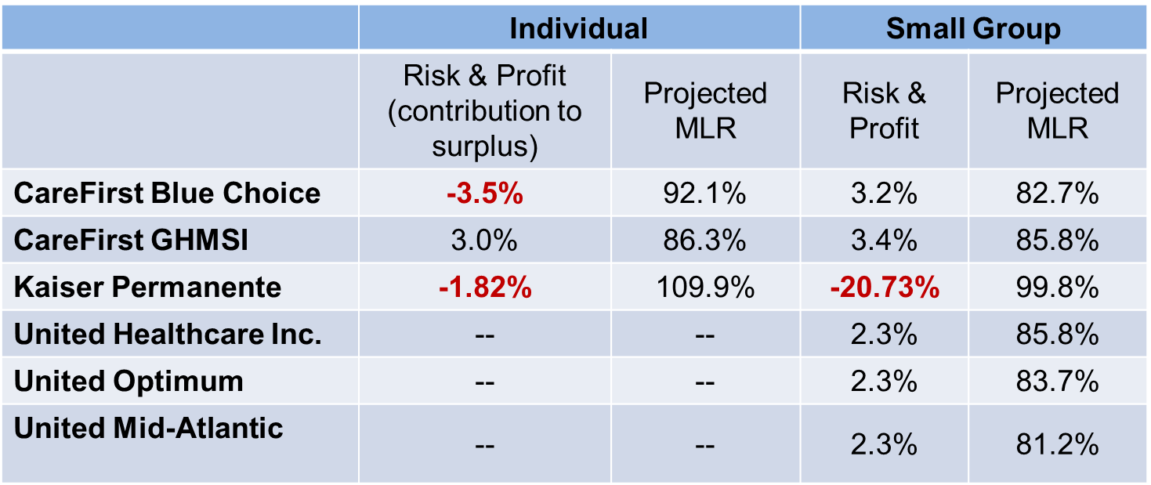
Risk & Profit in Insurer-Proposed 2025 Premiums and Projected Medical Loss Ratio (how much of the premium pays for care)

Slide 17
Summary of Recommendations
Insurer | Insurer Proposed Individual Market | OW Actuarial Analysis (actuarially justified rate) | HBX Recommendations Individual Marketplace | Insurer Proposed Small Group Market | OW Actuarial Analysis (actuarially justified rate) | HBX Recommendations Small Group Marketplace
CareFirst HMO | 3.60% | 1.45% | Individual market is unaffordable. Do not approve insurers’ proposed rates | 6.60% | 3.79% | Do not approve insurers’ proposed rates
CareFirst PPO (GHMSI) | 3.60% | -1.40% |  | 1.70% | -2.85%
Kaiser Permanente | 9.00% | 8.97% |  | 8.00% | 7.97%
United Optimum HMO | n/a |  |  | 5.08% | 1.70%
United PPO |  |  |  | 5.80% | 2.39%
United Mid-Atlantic HMO |  |  |  | 5.42% | 2.03%

Slide 18
Policy recommendation: do not approve requested small group premium increases
DC small business and non-profit community have not fully recovered from COVID.
Changes in local economy means many employers struggle to keep their doors open.
Insurers’ financials show significant surplus and can withstand less guaranteed profit built into the proposed rate increases.
DISB should approve rates that result in more of every premium dollar paying for medical care (higher projected MLR).

Slide 19
Conclusion
Thank you, Commissioner Woods for holding this hearing, for considering our recommendations, and for your leadership and work to protect insurance consumers.

